Slide 1




NMRS-LIMS
Request Results
Create Lab Order
Conclusion
Create Manifest
Login
Integration User Guide
February 2021

Slide 2
Training Objectives
Guide participants through the process of ordering lab tests on the NMRS
Show participants how to generate and send a manifest from NMRS to LIMS
Show participants how to request results from LIMS on the NMRS
Request Results
Create Lab Order
Conclusion
Create Manifest
Login

Slide 3
Overview of the EMR-LIMS Exchange Module
UMB has partnered with CHAI to enable the interoperability of the Laboratory Information Management System (LIMS) with EMRS (NMRS and LAMIS).
The goal is to allow feedback between facility laboratories and reference laboratories (PCR Labs)
The integration between the two systems leverages on an Application Programming Interface (API) to allow exchange of both sample logging Information from EMRs to LIMS and return of results from LIMS to EMRs.
Request Results
Create Lab Order
Conclusion
Create Manifest
Login

Slide 4
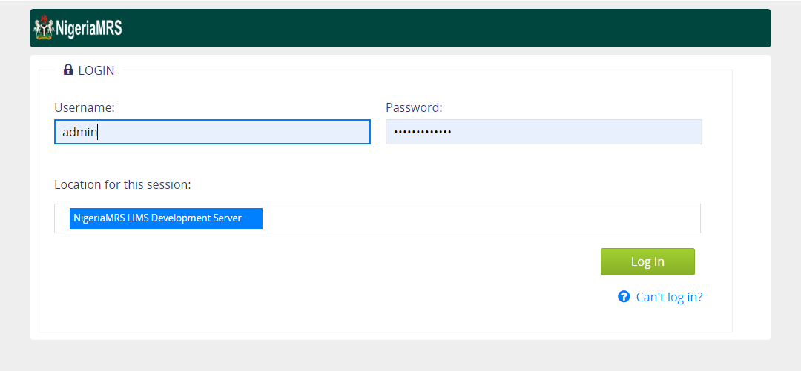
Getting Started
Enter username and password to access the NMRS instance
Create Lab Order
Request Results
Conclusion
Create Manifest
Login

Slide 5
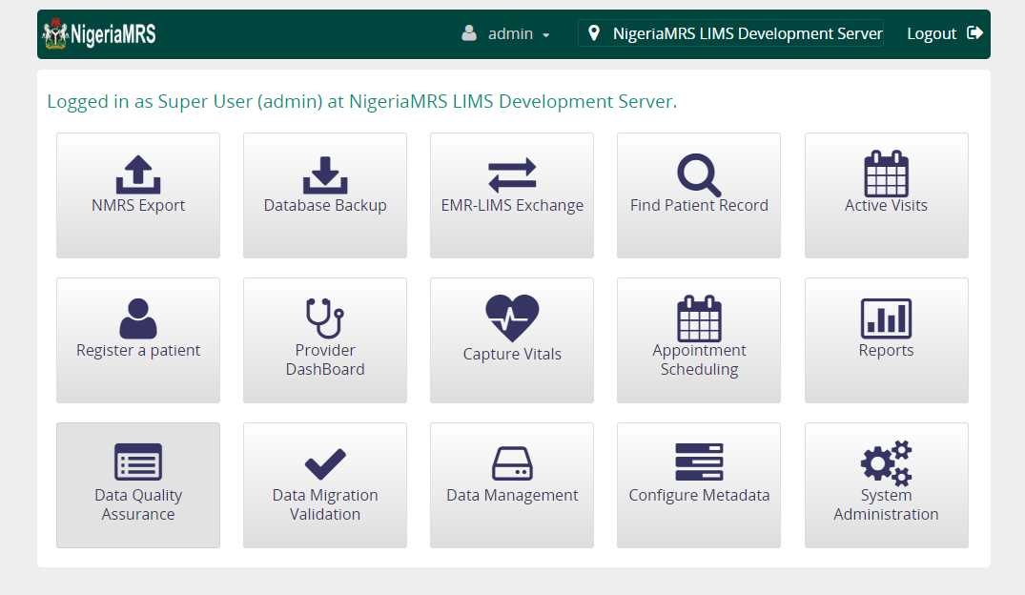
Lab Order Request Process
From the landing page, select the Find Patient Record Module
Request Results
Create Lab Order
Conclusion
Create Manifest
Login

Slide 6
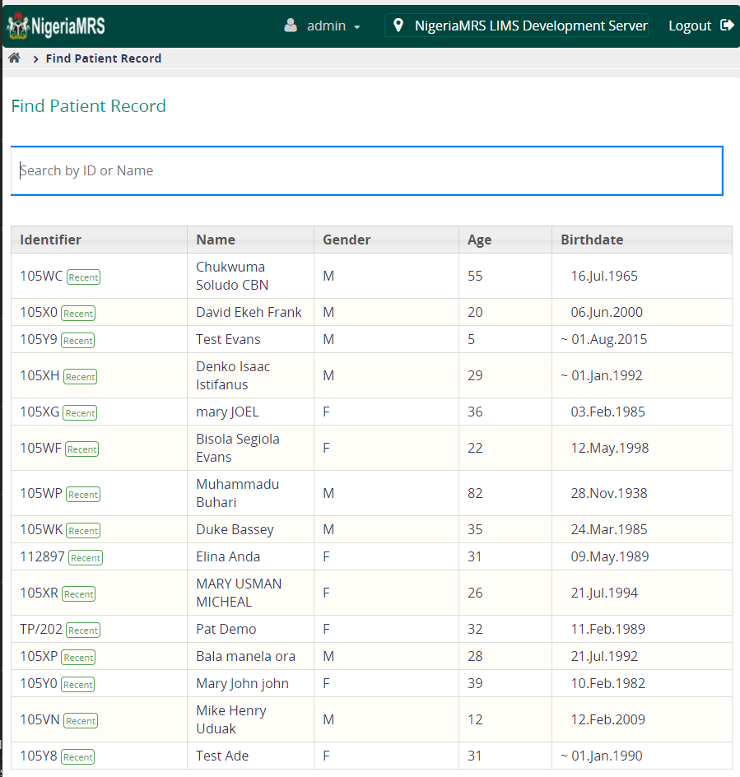
Selecting a Patient for Sample Collection
Request Results
Create Lab Order
Conclusion
Create Manifest
Login

Slide 7
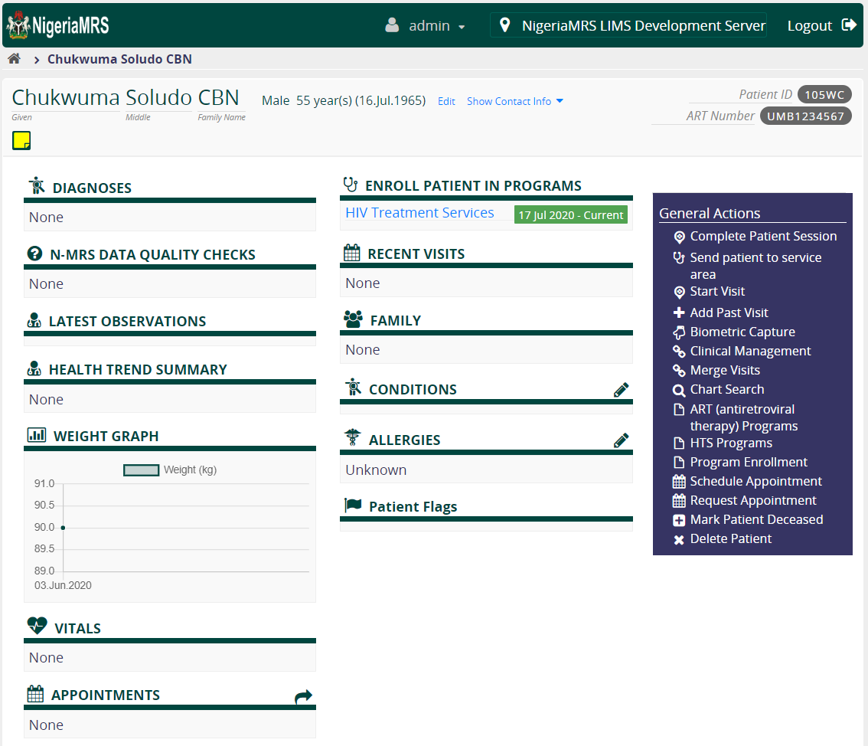
Selecting a Care Cascade
Request Results
Create Lab Order
Conclusion
Create Manifest
Login

Slide 8
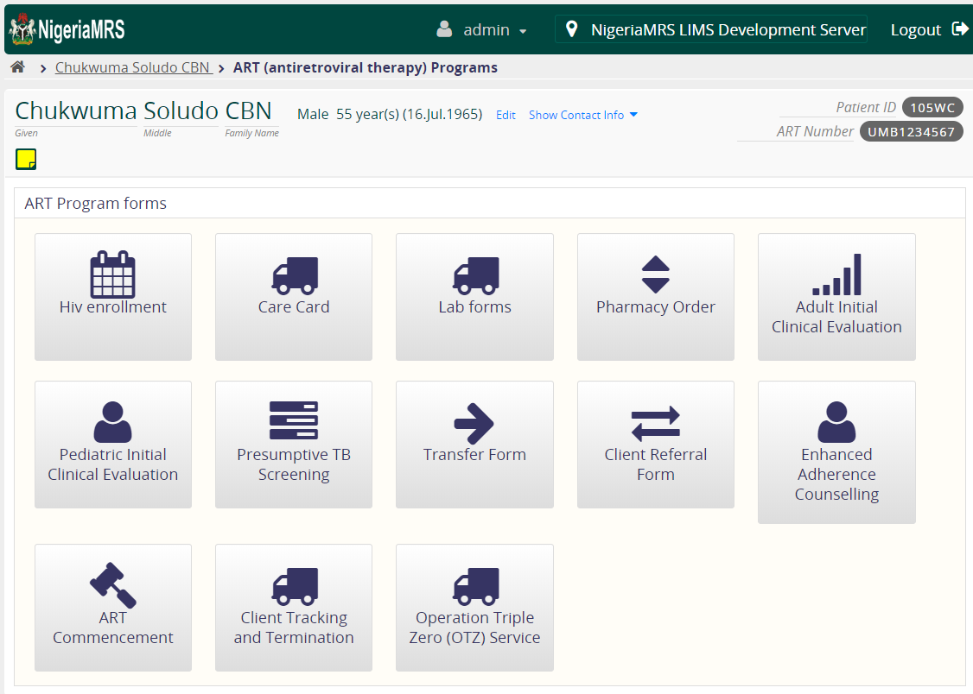
Ordering Lab Tests and Sample Collection
Request Results
Create Lab Order
Conclusion
Create Manifest
Login

Slide 9
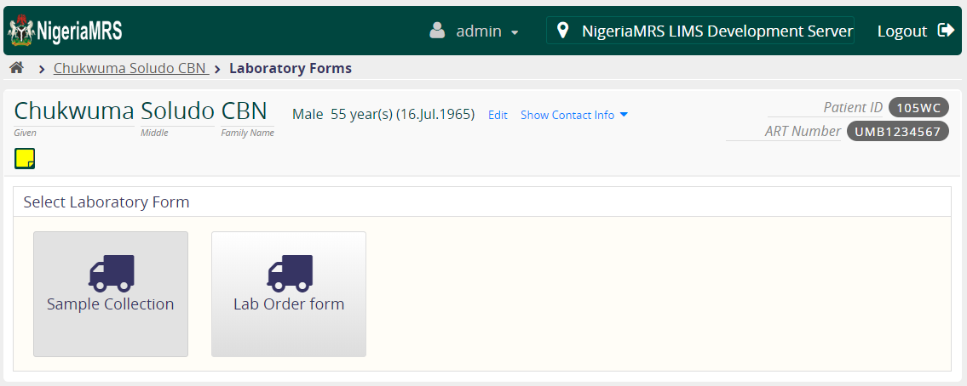
Laboratory Order and Result Form
Request Results
Create Lab Order
Conclusion
Create Manifest
Login
Note: Make use of the Lab Order Form only.

Slide 10
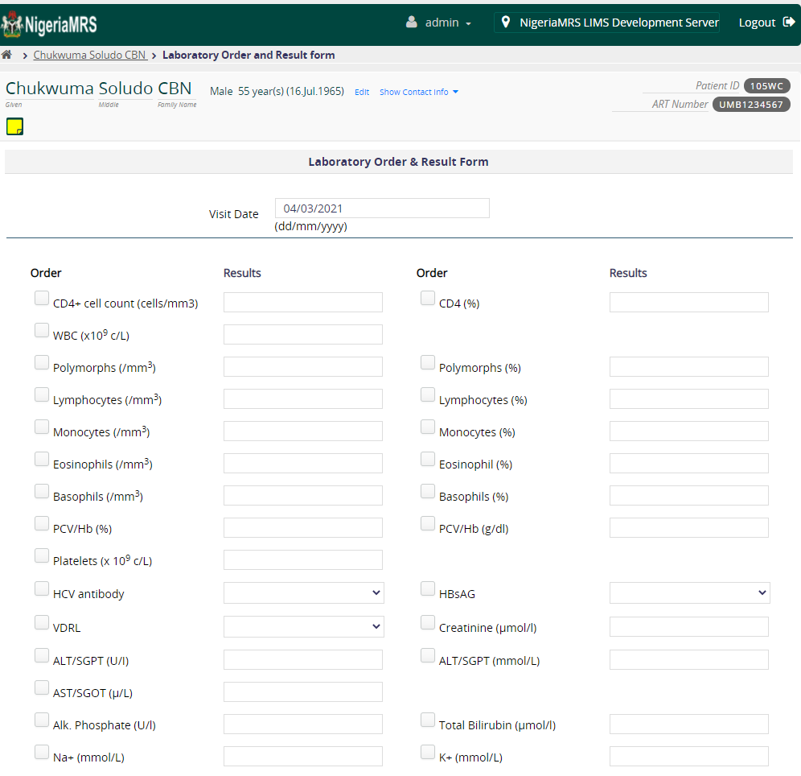
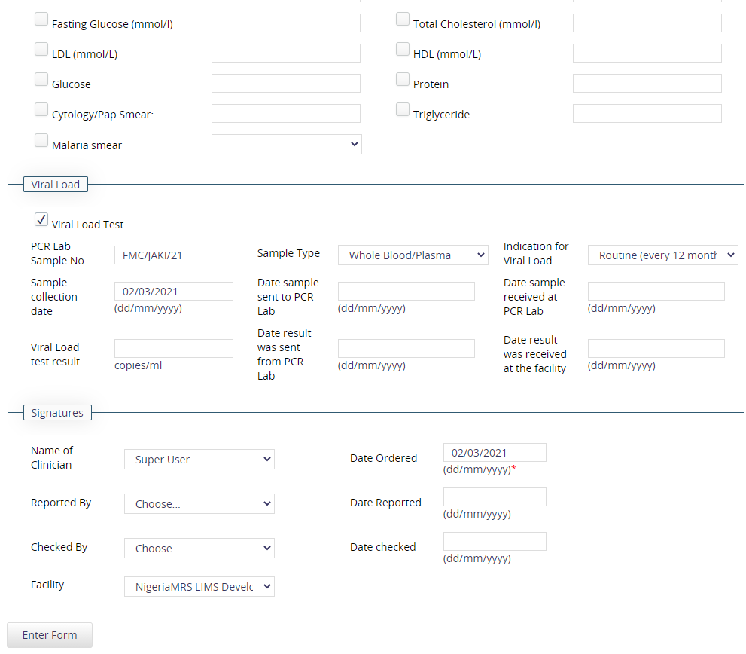
Ordering Viral Load Test
From the Lab order form, (PCR Sample No, Sample Type, Indication for Viral Load, Sample Collection, Name of Clinician & Date ordered) are required to be filled to avoid errors.
Request Results
Create Lab Order
Conclusion
Login

Slide 11
Getting Started
From the landing page, select the EMR-LIMS Exchange Module
This directs you to a page where you can either generate a manifest, view manifests or request results from the LIMS
Request Results
Create Lab Order
Create Manifest
Conclusion
Login

Slide 12
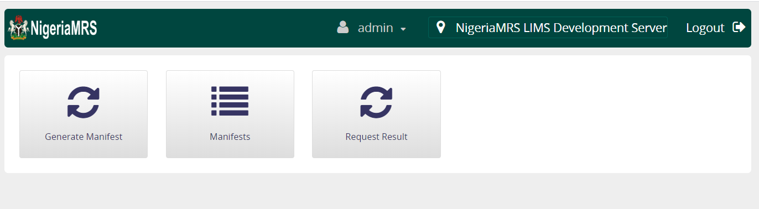
LIMS Module Dashboard
Select Generate Manifest to create a new manifest
The manifest contains the details of all the samples to be sent to the reference lab for testing
Request Results
Create Lab Order
Create Manifest
Conclusion
Login

Slide 13
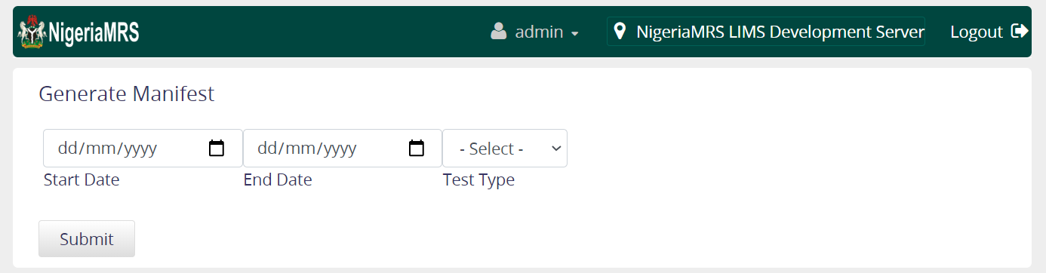
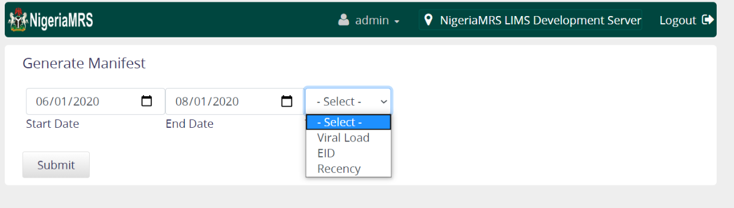
Generate Manifest
Enter a date range (Start and End Date) to retrieve the lab sample requests within the period
Next, select the test type for the samples being sent. Test types options are Viral Load; EID; or Recency.
Request Results
Create Lab Order
Create Manifest
Conclusion
Login

Slide 14
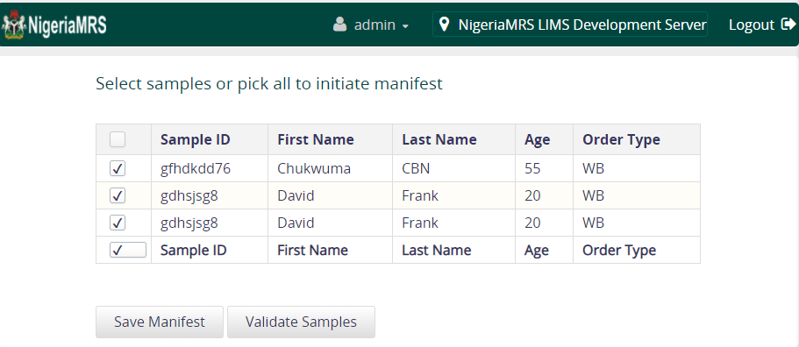
Samples Validation (1)
From the sample list, select the samples to be added to the manifest or select all if the entire list is to be added to the manifest and click Validate Samples
Request Results
Create Lab Order
Conclusion
Create Manifest
Login

Slide 15
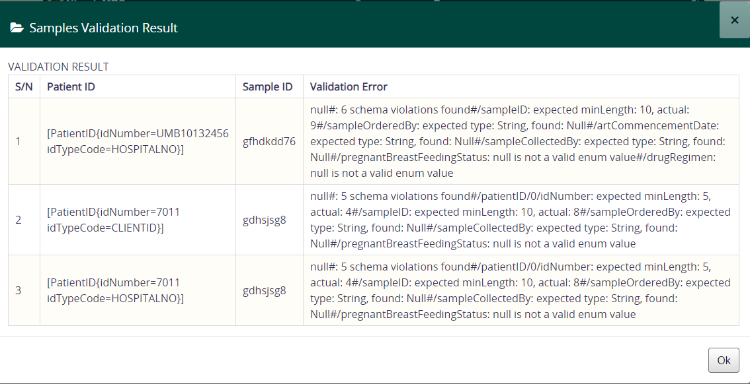
Samples Validation (2)
After Clicking “Validate Samples” a page pops up with the sample validation result. This helps to decipher errors.
Request Results
Create Lab Order
Conclusion
Create Manifest
Login

Slide 16
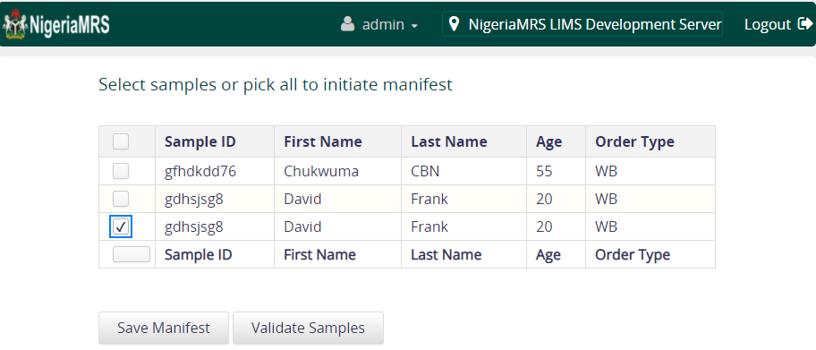
Generate Manifest (2)
From the sample list, select the samples to be added to the manifest or select all if the entire list is to be added to the manifest and click Save Manifest
Request Results
Create Lab Order
Conclusion
Create Manifest
Login

Slide 17
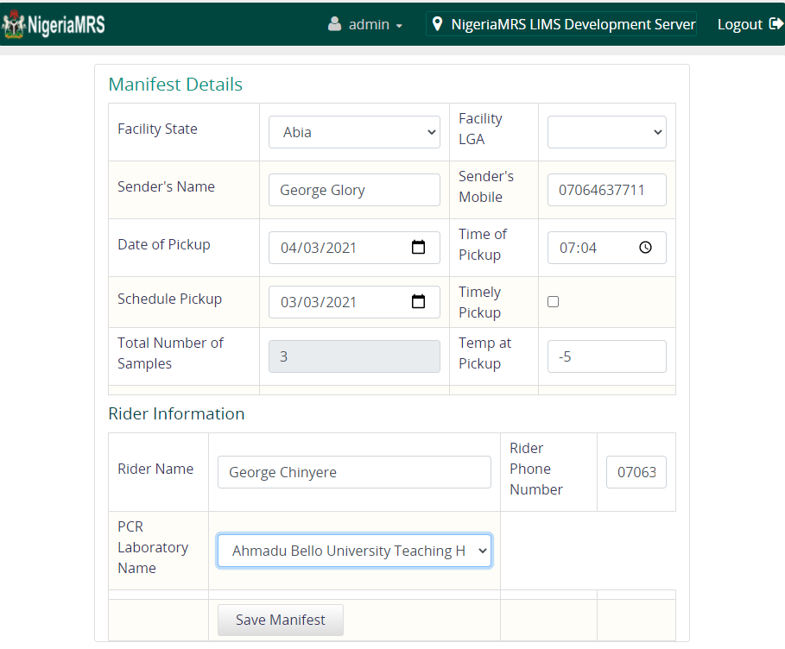
Generate Manifest (3)
Fill in manifest details including facility demographics, sender’s details, date of pickup, schedule pickup, temperature at time of pickup, rider’s details and PCR Lab name
Request Results
Create Lab Order
Create Manifest
services
Login

Slide 18
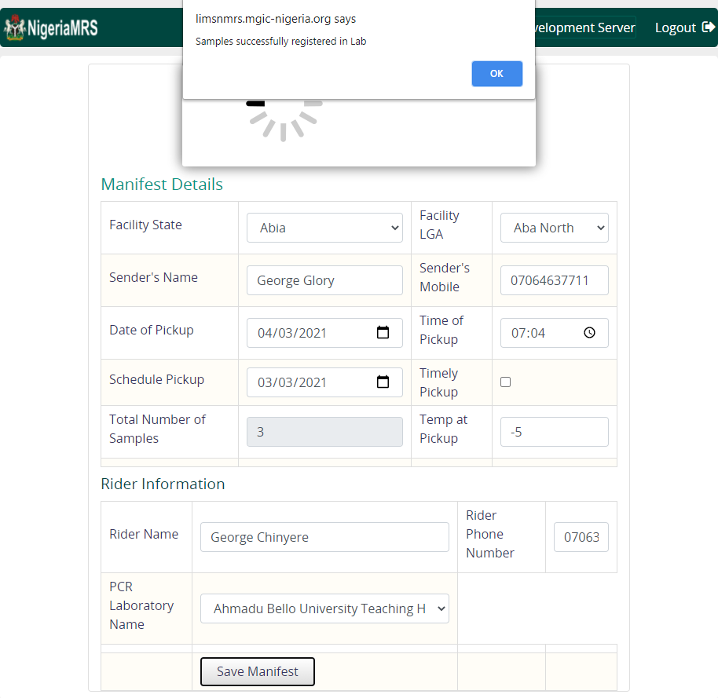
Generate Manifest (4)
After Clicking on “Save Manifest”, wait till a notification bar pops up stating that “Samples successfully registered in Lab”
Request Results
Create Lab Order
Create Manifest
services
Login

Slide 19
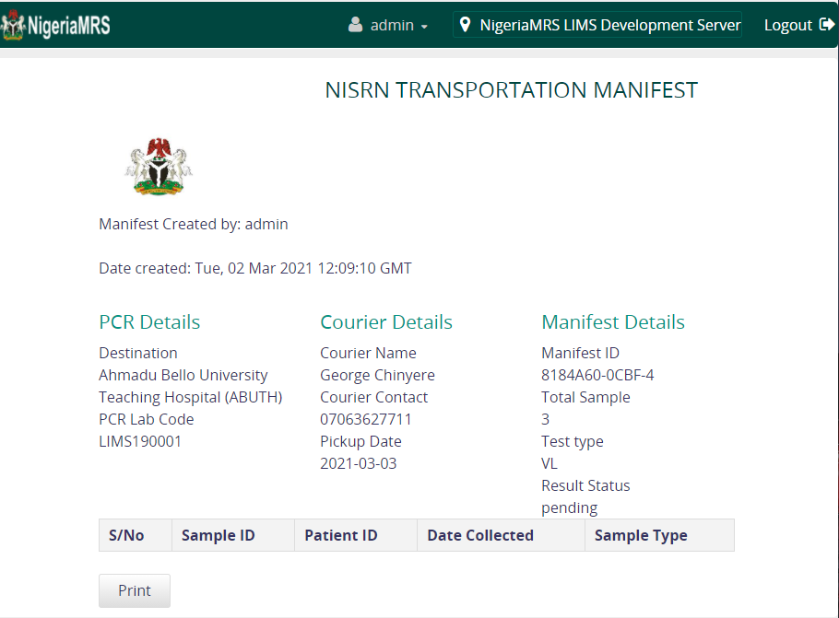
Generate Manifest (5)
Once the manifest has been saved the details of the samples are sent to LIMS where it is logged in preparation for testing and result entry
On successful submission to LIMS, the manifest summary is generated for printing and given to the rider during sample transportation.
Request Results
Create Lab Order
Create Manifest
services
Login

Slide 20
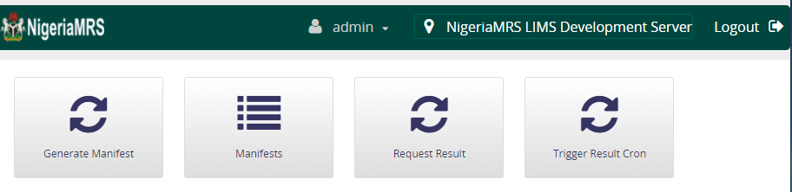
Request Results from LIMS
Select Request Result to view results available for manifests sent to the reference lab for testing Manually.
Request Results
Conclusion
Create Lab Order
Create Manifest
Login

Slide 21
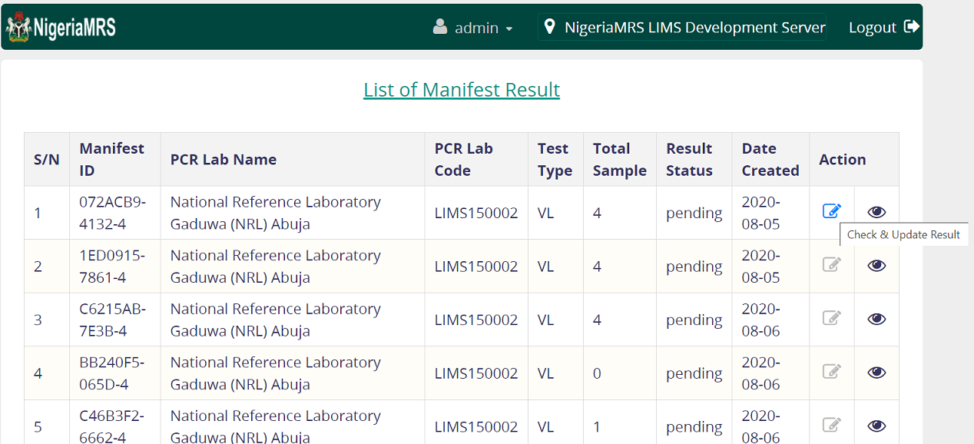
Request Results from LIMS (2)
Select Check and Update Result to check results available on each manifest and automatically update on patient’s record.
Request Results
Conclusion
Create Lab Order
Create Manifest
Login

Slide 22
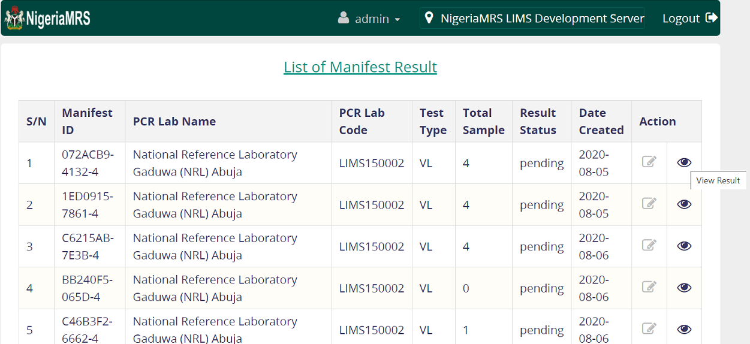
Request Results from LIMS (3)
Select View Result to view results available on each manifest.
Request Results
Conclusion
Create Lab Order
Create Manifest
Login

Slide 23
Request Results from LIMS
Select Trigger Result Cron to automatically check all results available on all manifests and update to patient’s records.
Request Results
Conclusion
Create Lab Order
Create Manifest
Login

Slide 24
THANK YOU
Request Results
Create Lab Order
Create Manifest
Conclusion
Login

